Slide 1
IMPORTANCE OF IDEAL REMUNERATION SYSTEM
UNIT-3

Slide 2
FACTORS INFLUENCING REMUNERATION SYSTEM
External Factors
Internal Factors

Slide 3
External Factors
Labour Market
Demand for and supply of labour influence wage and salary fixation. A low wage may be fixed when the supply of labour exceeds the demand for it. A higher wage will have to be paid when the demand exceeds supply, as in the case of skilled labour.
Cost of Living
Next in importance to labour market is the cost of living. This criterion matters during periods of rising prices, and is forgotten when prices are stable or falling. The justification for cost of living as a criterion for wage fixation is that the real wages of workers should not be allowed to be whittled down by price increases. A rise in the cost of living is sought to be compensated by payment of dearness allowance, basic pay to remain undisturbed. Many companies include an escalatory clause in their wage agreements in terms of which dearness allowance increases or decreases depending upon the movement of consumer price index (CPI).

Slide 4
External Factors
Labour Unions
The presence or absence of labour organizations often determine the quantum of wages paid to employees. Employers in non-unionized factories enjoy the freedom to fix wages and salaries as they please. Because of large-scale unemployment, these employers hire workers at little or even less than legal minimum wages.
Labour Laws
We have a plethora of labour laws at the central as well as at the state levels. Some of the central laws which have a bearing on employee remuneration are the Payment of Wages Act, 1936; the Minimum Wages Act, 1948; the Payment of Bonus Act, 1965; Equal Remuneration Act, 1976; and the Payment of Gratuity Act, 1972. The Payment of Wages Act was passed to regulate payment of wages to certain classes of persons employed in the industry.

Slide 5
External Factors
Society
Remuneration paid to employees is reflected in the prices fixed by an organization for its goods and services. For this reason, the consuming public is interested in remuneration decisions. The Supreme Court, from its very inception, has had to adjudicate industrial disputes-particularly disputes relating to wages and allied problems of financial concern to the worker- an ethical and social outlook liberally interpreting the spirit of the Constitution.
The Economy
The last external factor that has its impact on wage and salary fixation is the state of the economy. While it is possible for some organizations to thrive in a recession, there is no question that the economy affects remuneration decisions. For example, a depressed economy will probably increase the labour supply. This, in turn, should serve to lower the going wage rate.

Slide 6
Internal Factors
Business Strategy
The overall strategy which a company pursues should determine the remuneration to its employees. Where the strategy of the enterprise is to achieve rapid growth, remuneration should be higher than what competitors pay. Where the strategy is to maintain and protect current earnings, because of the declining fortunes of the company, remuneration level needs to be average or even below average.
Job Evaluation and Performance Appraisal
Job evaluation helps establish satisfactory wage differentials among jobs. Performance appraisal helps award pay increases to employees who show improved performance.
The Employee
Several employee-related factors interact to determine his or her remuneration. These include performance, seniority, experience, potential, and even sheer luck.

Slide 7
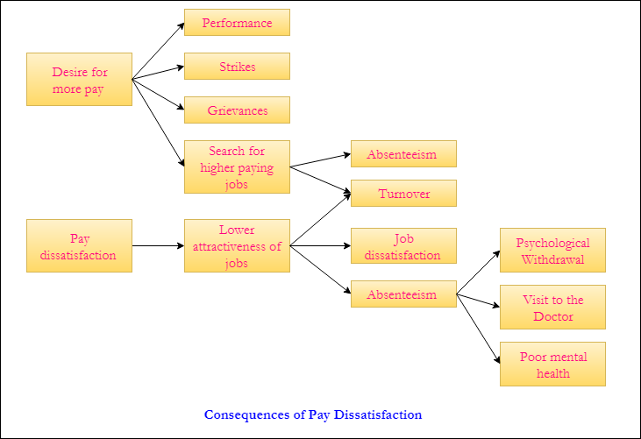
IMPORTANCE OF IDEAL REMUNERATION SYSTEM

Slide 8
IMPORTANCE OF IDEAL REMUNERATION SYSTEM
Attracting Top Talent
People are always looking to put themselves in the best possible position financially. Those who are worth a specific salary amount often know their value and will seek a position that pays accordingly. Do research on what your competitor's compensation and benefits packages look like. Make sure you offer a similar package to your potential employees so that you attract the best candidates for your company. Hiring the right candidate the first time reduces recruiting costs and helps free up business owners for other tasks.

Slide 9
IMPORTANCE OF IDEAL REMUNERATION SYSTEM
Increased Employee Motivation
Properly compensating employees shows you value them as workers and as human beings. When people feel valued, they feel better about coming in to work. Overall company morale increases and people are motivated to come to work and do a good job. Additionally, when employees know there are bonuses or commissions, they are increasingly motivated to deliver grander results. Bonus and commission compensation plans become a focal point for success.

Slide 10
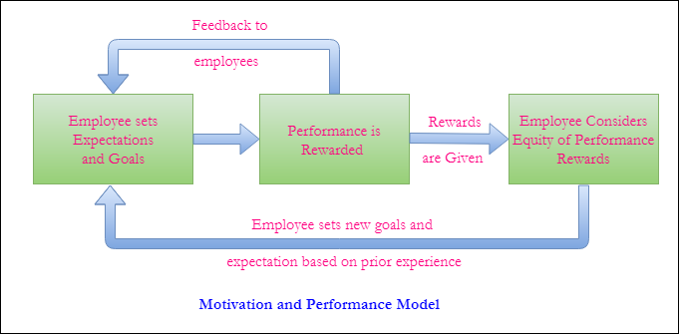
IMPORTANCE OF IDEAL REMUNERATION SYSTEM
Increased Employee Motivation

Slide 11
IMPORTANCE OF IDEAL REMUNERATION SYSTEM
Boost Employee Loyalty
When employees are being paid well and are happy, they're likely to stay with the company. Proper compensation is one factor why employees remain with employers. Loyalty means that business owners don't need to continue to spend time, money and energy on recruiting new candidates. Employee retention and low-turnover rates are great for employers who cultivate a team that knows what to do. That team is also motivated to be part of the team, and they get the job done well.

Slide 12
IMPORTANCE OF IDEAL REMUNERATION SYSTEM
Increased Productivity and Profitability
Happy employees are productive employees. Productivity in relation to compensation starts with employees feeling valued which increases motivation and loyalty. Not only are employees more motivated to do a good job, but also, the longer people are with the company, the more they know and the more efficient they become. All of this leads to increased productivity.

Slide 13
IMPORTANCE OF IDEAL REMUNERATION SYSTEM
Job Satisfaction So People Stay
Creating the right compensation plan leads to stronger job satisfaction. The right compensation plan includes benefits, along with all the other bonuses available. Employees often boast about holiday bonuses or they keenly watch how the company stock performs because they have stock options. The right compensation program invests employees into the work being done, which gives them a stronger sense of satisfaction when the company succeeds. They know they will be rewarded for their efforts; everyone likes to be appreciated.

Slide 14
REMUNERATION PLAN & BUSINESS STRATEGY
Business Strategy | Market Position & Maturity | Remuneration Strategy | Blend of Remuneration
Invest to Grow | Merging or growth rapidly | Simulate entrepreneurialism | High Cash / Average Incentives/ Modest Benefits
Manage earnings – protect markets | Normal growth to maturity | Reward management skills | Average Cash / Moderate Incentives/ Standard Benefits
Harvest earnings – reinvest elsewhere | No real growth or decline | Stress on cost control | Below Average Cash/ Small Incentives/ Standard Benefits

Slide 15
Devising a remuneration plan
Job Description
Job Evaluation
Pricing jobs
Job hierarchy
Pay Survey

Slide 16
Devising a remuneration plan
Job Description
Job descriptions are crucial in designing pay systems, for, they help to identify important job characteristics. They also help determine, define and weigh compensable factors (factors for which an organization is willing to pay- skill, experience, effort and working environment).
Job Evaluation
The next step in pay fixation is to establish relative worth of jobs by employing job evaluation. A number of techniques are available to evaluate jobs. For example, in the point-ranking method of job evaluation, each job is analyzed and defined in terms of the compensable factors an organization has agreed to adopt. Points are assigned to each .degree of a compensable factor, such as responsibility.

Slide 17
Devising a remuneration plan
Job Hierarchy
The points assigned to all compensable factors are aggregated. The total points scored will help establish the hierarchy of job worth, starting from the highest point total to the lowest point total.
Pay Survey
Job hierarchy being established, the next step is to establish pay differentials. Before fixing wage and salary differentials, prevailing wage and salary rates in the labour market need to be ascertained. Hence the relevance of pay surveys.
Pricing Jobs
In pricing jobs, the job evaluation worth is matched with the labour-market worth. Two activities need to be performed: (i) establishing the appropriate pay level for each job, and (ii) grouping the different pay levels into pay grades.

Slide 18
Challenges to Remuneration
Remuneration
Skill-based pay
Salary reviews
Pay secrecy
Comparable worth
Employee participation

Slide 19
Challenges to Remuneration
Skill-Based Pay : In the skill based system, workers are paid on the basis of number of jobs they are capable of doing, or on depth of their knowledge. The purpose of this system is to motivate employees to acquire additional skills so that they become more useful to the organization.

Slide 20
Challenges to Remuneration
Salary Reviews :
Salary, once determined, should not remain constant. It must be reviewed and challenged often, but how often becomes a relevant question. Pay reviews may be made on predetermined dates, anniversary dates or there could be flexible reviews. In the fixed-date reviews, wages and salaries of all employees are reviewed and raised on a specified date each year. In the anniversary-date review, salaries may be reviewed at twelve-month intervals from the date of the employee’s anniversary date of hire. Using variable timing ensures flexibility. In addition, high-performing employees, who are low on their salary ranges, can be rewarded more frequently

Slide 21
Challenges to Remuneration
Pay Secrecy : The process by which a remuneration plan is designed and administered is critical for any organization. One challenge facing HRM concerns the availability of information about remuneration to employees. The tendency among most firms is to maintain pay secrecy as this would help avoid pay comparisons likely to be made by employees

Slide 22
Challenges to Remuneration
Comparable Worth : One of the popular principles in employee remuneration is equal pay for work. Infact, this principle has been the inspiration behind the enactment the Equal Remuneration Act. Under the act, male and female nurses are to be paid the same if their merit and seniority match, but a female and a male electrician could be paid different rates.

Slide 23
Challenges to Remuneration
Employee Participation : When employees are involved in designing a remuneration plan, they exhibit little resistance in accepting it. Such a plan is much more likely to be a successful motivator than the one imposed by the management.

Slide 24
ANY QUERY

